Slide 1

Intro to Unity – Using Github
By: Jeremy nIELSON

Slide 2
Initial Requirements
Make sure you have setup and created your GitHub account
Ensure you have a terminal to use git.
Git for Windows: https://gitforwindows.org/
Git LFS: https://git-lfs.github.com/
Familiarize yourself with basic git commands
IMPORTANT NOTE
git-lfs in terminal is free to use, but keep in mind the Github repo max capacity is 1GB standard

Slide 3
Using a .gitignore
This file ensures that certain user-specified files or directories are not committed to GitHub.
All projects should have a .gitignore/readme
A standard unity .gitignore can be found here
The .gitignore we will use can be found in the part 1 project folder

Slide 4
Using a .gitattributes
This file keeps track of all the file types that Unity supports.
Be sure that both the .gitignore and .gitattributes files are in the base of your project folders

Slide 5
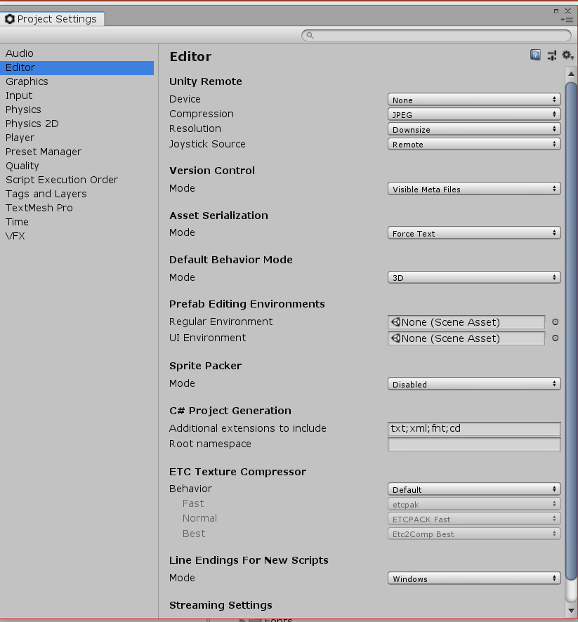
Setup Unity – Version Control
In your project:
Edit > Project settings > Editor
Under Version Control: Mode (Visible Meta Files)
Asset Serialization: Mode (Force Text)
Save changes

Slide 6
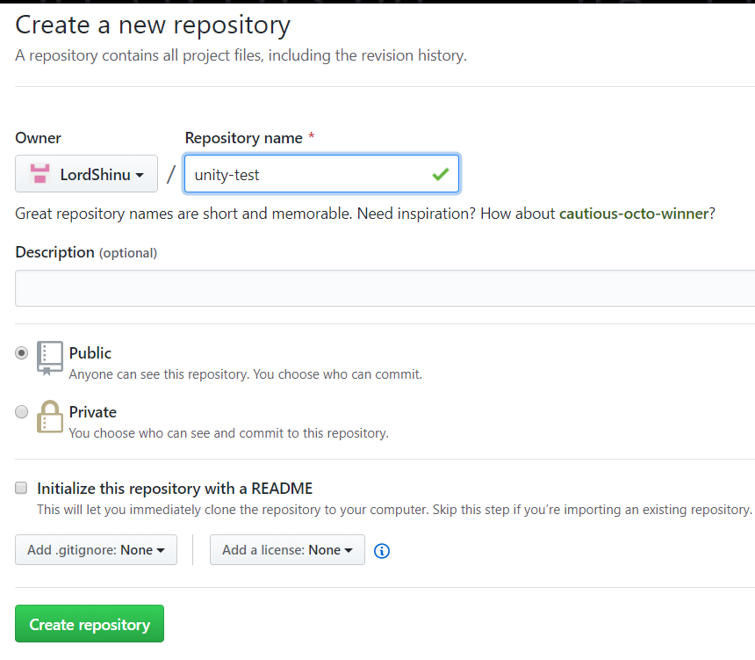
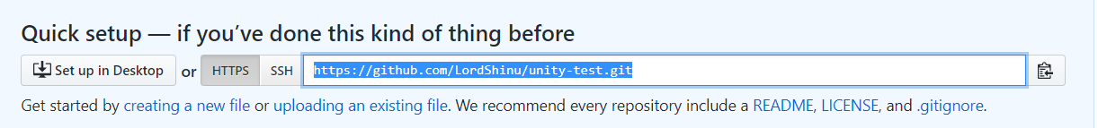
Creating a GitHub Repo
Start by creating an empty repository on github
Once created, copy the link to your repository
There will be a number of commands needed to be ran in your local repository

Slide 7
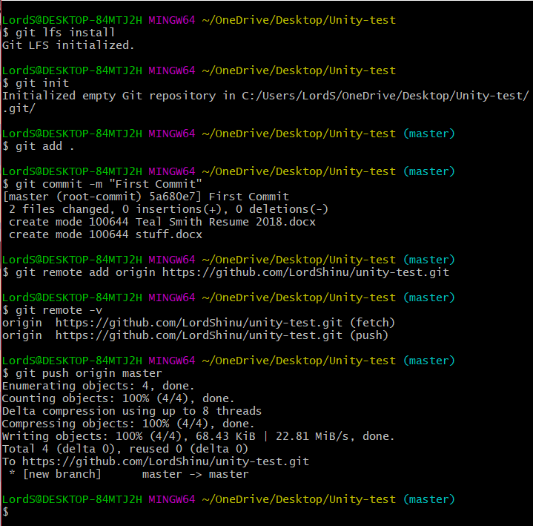
Git – In Terminal
Run the following commands in your repository:
git lfs install
git init
git add .
git commit –m “First Commit”
git remote add origin [url]
git remote –v
git push origin master

